Slide 1


A Sign Language Translation Robot: From Signs to Speech and Text
Group：Splash Brothers
Xu Xuekai 1009657
Wang Jingyi 1009722

Slide 2

Catalogue
1.Introduction
2.Problem statement
3.Proposed approach
4.Timeline
5.References

Slide 3
1.Introduction

Slide 4

Introduction: Background & Motivation
Background:
Around 430 million people worldwide have disabling hearing loss, and China has the largest number.
Most deaf individuals (78–89%) understand under 60% of sign-language news, making it hard to get information.
Only about 40% of needed accessibility infrastructure exists, so daily life and mobility are difficult.
Motivation
1. To make sign language translation more accessible, accurate, and portable.
2. To enable cross-language sign interpretation:
CSL ↔ ASL, Chinese ↔ English.

Slide 5

Introduction:State of art
Early work focused on isolated word recognition, while current efforts address the more challenging continuous sign language recognition, which requires robust temporal modeling and contextual understanding. Deep learning models—capable of extracting spatial features, handling temporal sequences, and capturing long-range dependencies—have therefore become the mainstream approach.
In academia, there is already some work on cross-language continuous sign language recognition, transfer learning, and multilingual translation, and industry is also developing related prototypes, but overall maturity still needs to be improved.

Slide 6
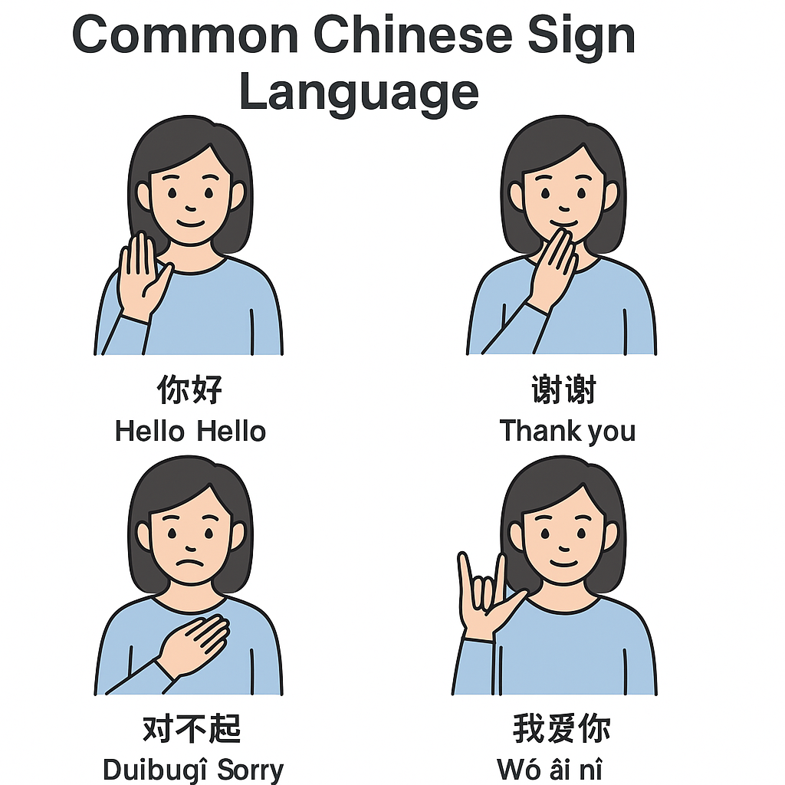
Basic Information on Chinese Sign Language (CSL)
Chinese Sign Language (CSL) is a visual language system used by the deaf community in China. It has its own grammar, vocabulary, and expression rules, and is not a direct manual translation of spoken Chinese. CSL conveys meaning through hand gestures, facial expressions, and body movements.
CSL uses both one-handed and two-handed gestures, depending on the specific word or phrase:
👋 One-handed signs: Common for simple words like “hello” or “thank you”
✋🤚 Two-handed signs: Often used for complex concepts, verbs, or to enhance clarity

Slide 7
Introduction: Literature review
Sign-to-text/translation: The mainstream approach has evolved from the traditional “recognize (gloss-level) then translate” pipeline to direct end-to-end Transformer models, supplemented by self-supervised pre-training and lightweight keypoint-based methods , showing clear gains on public datasets but still needing more data and optimization for large-scale, diverse scenarios.
Cross-language continuous sign recognition: Emerging work mainly leverages cross-language feature sharing, few-shot/transfer learning, and multilingual pre-training to exploit similarities among sign languages, but due to scarce parallel corpora and visual–semantic mismatches, the field remains exploratory and requires larger aligned datasets and finer mapping strategies.

Slide 8
Introduction: Difference between CSL & ASL
Comparison Aspect | Chinese Sign Language (CSL) | American Sign Language (ASL)
Grammar Structure | Similar to Chinese SVO word order | Topic-comment or OSV structure
Vocabulary Source | Influenced by Chinese characters and stroke order | Originated from French Sign Language, not directly tied to English
Expression Style | Mainly relies on handshapes and movements | Extensive use of facial expressions for grammar
Relation to Spoken Language | Closely related to spoken Chinese | Significantly different from spoken English

Slide 9
2.Problem statement

Slide 10
Problem statement: Technical gaps
Limited accuracy in real-world sign recognition
Lack of full-sentence understanding
No direct CSL–ASL translation system
Few high-quality CSL datasets
Hardware constraints

Slide 11
Problem statement: Challenges
Achieving real-time, high-accuracy gesture-to-text conversion
Developing a bilingual translation chain (sign ➝ language ➝ second language)
Creating a smooth and natural speech output for non-verbal users
Building and labeling a diverse CSL/ASL dataset from scratch
Balancing performance, power consumption, and cost in the robot design

Slide 12
Problem statement: Project objectives & Goals
Real-Time Sign Language Recognition
Bilingual Translation Capability
Multimodal Output System
Lightweight and Portable Robot Integration
User-Centric Design & Testing

Slide 13
3.Proposed approach

Slide 14

Design Thinking Process
1. Empathize:
- Conducted interviews and observations with deaf individuals and educators.
- Collected insights through fieldwork and questionnaires.
2. Define:
- Identified the core issue: lack of real-time, accurate translation between deaf and hearing people.
- Outlined key technical challenges such as gesture diversity and sign language dialects.

Slide 15
Design Thinking Process
3. Prototype:
- Created low- to high-fidelity prototypes using Unity and TensorFlow.
- Integrated voice output and real-time captioning features.
4. Test:
- Piloted the system in schools and public service scenarios.
- Collected user feedback and iterated design based on real usage data.

Slide 16
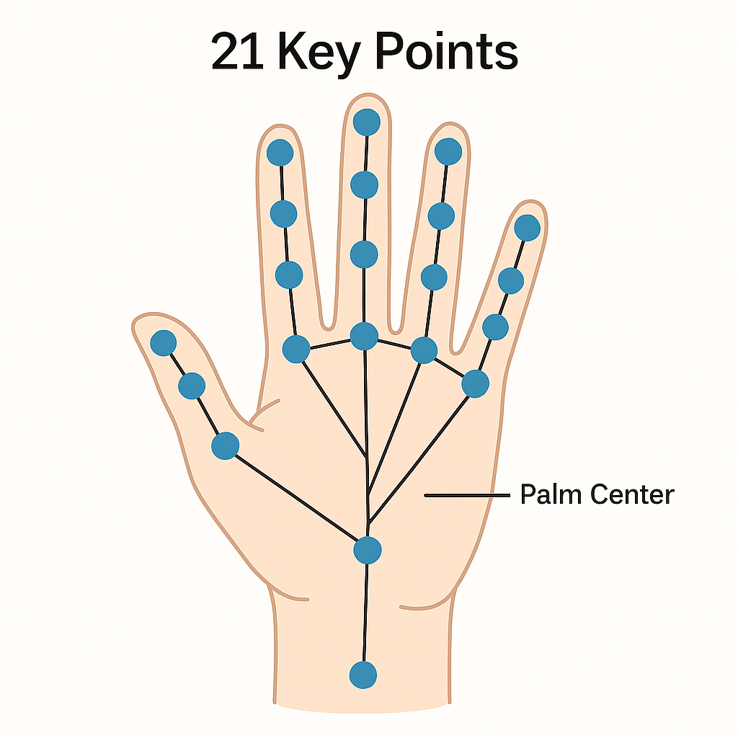
Using Leap Motion for Sign Language Recognition
21 Key Points Captured
Leap Motion captures 21 hand key points for each hand, which include:
5 fingertips (thumb to pinky)
4 finger joints per finger (MCP, PIP, DIP, Tip)
Palm center
Each point provides x, y, z coordinates, enabling detailed spatial representation of hand poses and gestures.

Slide 17
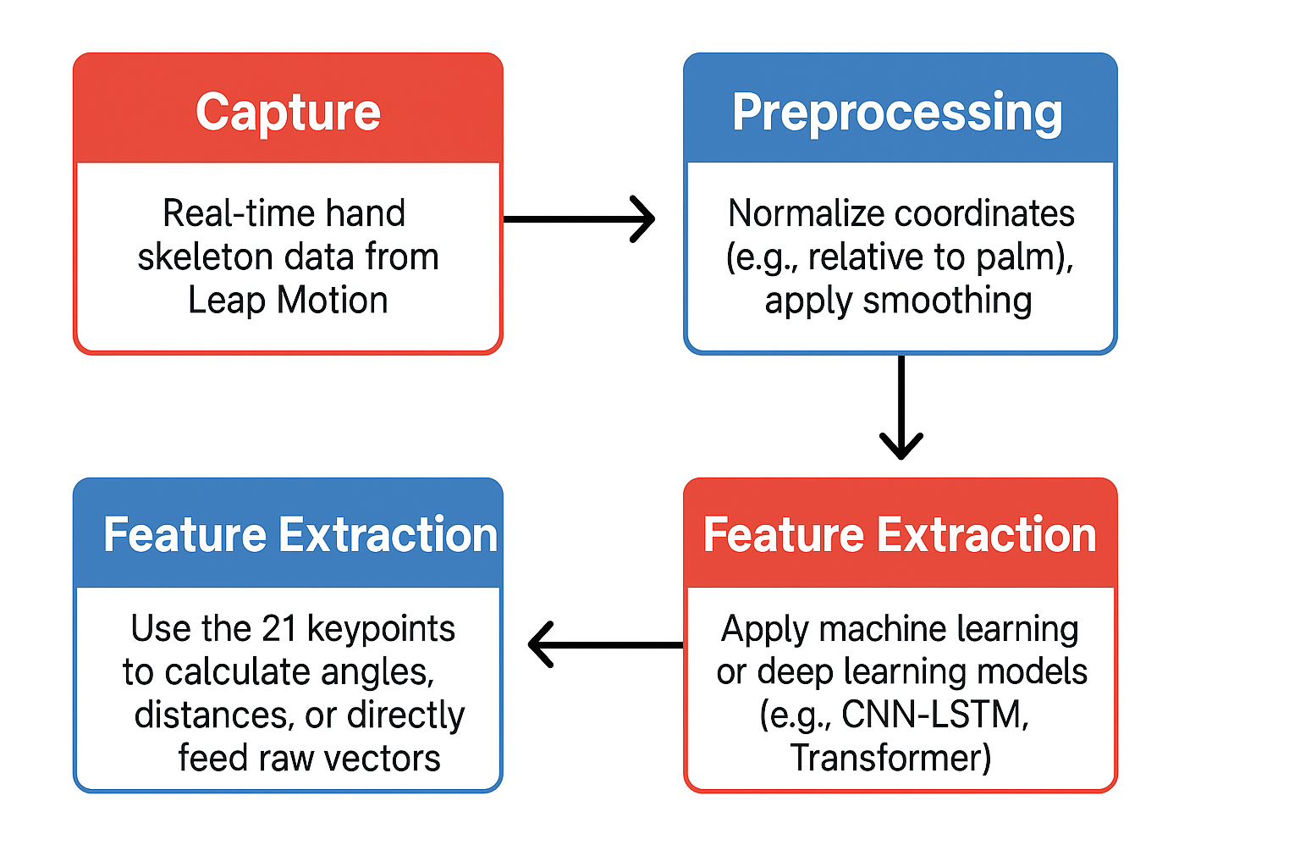
Typical Pipeline

Slide 18

Methodology
1. User-Centered Design:
- Every decision is grounded in real user behavior and feedback.
- Continuous testing and adaptation based on user input.
2. Pretotyping & Prototyping:
- Pretotyping: Used Fake Door and Pinocchio methods to test early demand and usability.
- Prototyping: Built functional MVPs and conducted real-world pilot testing.

Slide 19
Methodology
3. Agile Development:
- Two-week sprints focusing on specific system components.
- Iterative refinement of gesture recognition, UI/UX, and performance.
4. Feasibility Validation:
- Technical: Validated gesture recognition with CNN + LSTM models.

Slide 20
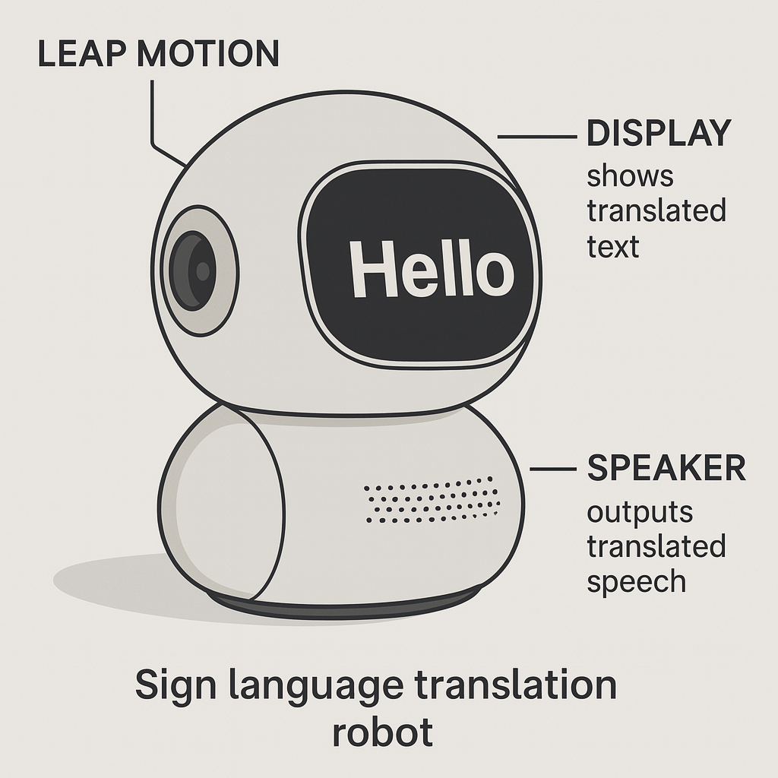
Preliminary Concept for Robot Construction
Our current focus is on software development, hardware implementation will be considered if time allows.

Slide 21
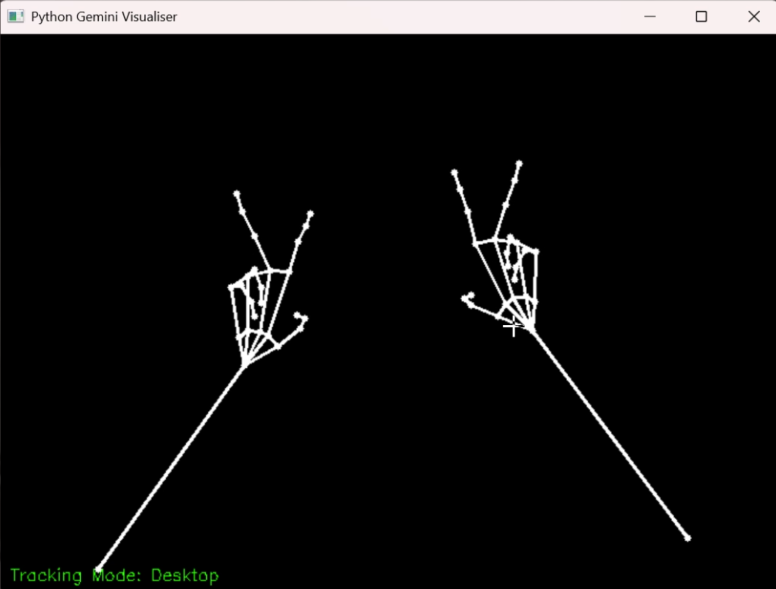
Desired result
Hello

Slide 22
4.Timeline

Slide 23
Date Range | Activity
May 27 – Jun 2 | Team formation, user research, define MVP features
Jun 3 – Jun 9 | Literature review, problem framing, finalize proposal
Jun 10 – Jun 16 | Design framework, identify key modules & workflow
Jun 17 – Jun 23 | Define sign recognition + translation logic (CSL/ASL)
Jun 24 – Jun 30 | Data collection, preprocessing, hand keypoint labeling
Jul 1 – Jul 7 | Build prototype pipeline: keypoint -> gesture -> sentence
Jul 8 – Jul 14 | Speech synthesis + UI/UX mock-up integration
Jul 15 – Jul 21 | Build bilingual (CN/EN) translation + feedback system
Jul 22 – Jul 28 | Alpha test (small users), collect feedback, debug
Jul 29 – Aug 4 | Model tuning & performance validation
Aug 5 – Aug 11 | Prepare technical report, demo video, slides

Slide 24
5.Reference

Slide 25
5.Reference (Sign Language → Spoken/Written Language Translation)
1.Camgoz, N. C., Koller, O., Hadfield, S., & Bowden, R. (2020). Sign Language Transformers: Joint End-to-end Sign Language Recognition and Translation. In Proceedings of the IEEE/CVF Conference on Computer Vision and Pattern Recognition Workshops (pp. 7844–7854).
2.De Coster, M., Shterionov, D., Van Herreweghe, M., & Dambre, J. (2022). Machine Translation from Signed to Spoken Languages: State of the Art and Challenges. arXiv preprint arXiv:2202.03086.
3.Yin, K., & Read, J. (2020). Better Sign Language Translation with STMC‑Transformer. arXiv preprint arXiv:2004.00588.
4.Zhang, B., Müller, M., & Sennrich, R. (2023). SLTUNET: A Simple Unified Model for Sign Language Translation. arXiv preprint arXiv:2305.01778.
5.Baumgartner, L., Jauss, S., Maucher, J., & Zimmermann, G. (2020). Automated Sign Language Translation: The Role of Artificial Intelligence Now and in the Future. In Proceedings of the 4th International Conference on Computer–Human Interaction Research and Applications (pp. 170–177).
6.Camgoz, N. C., Hadfield, S., Koller, O., Bowden, R. (2018). Sign2Gloss2Text: A Neural Framework for Sign Language Translation. ECCV.
7.De Coster, M., et al. (2024). A Survey on Sign Language Machine Translation. Expert Systems with Applications, 219, 119650.

Slide 26
5.Reference (Bilingual Sign Translation & Additional References)
8.Yazdani, S., Van Genabith, J., & España-Bonet, C. (2025). Continual Learning in Multilingual Sign Language Translation. In NAACL-HLT Long Papers (pp. 10923–10938).
9.Wei, C., Liu, Y., & Gao, J. (2023). CiCo: Domain-Aware Sign Language Retrieval via Cross-Lingual Contrastive Learning. In CVPR.
10.Wei, W., et al. (2023). (Improving Continuous CSLR with Cross-Lingual Signs). In ICCV Workshops.
11.Cheng, Y., & Wei, F. (2023). A Survey on Chinese Sign Language Recognition. ScienceDirect.
12.Pezzuoli, F., Tafaro, D., Pane, M., & Corradini, M. L. (2020). Development of a Sign Language Translation System for ASD. 2020.
13.Dreuw, P., et al. (2008). Spoken Language Processing Techniques for Sign Language Recognition and Translation. RWTH Aachen University.

Slide 27

Thanks

